Slide 1


Space Rover Community
Progress Presentation #1

Slide 2
Outline:
1- Sub-team Progress
2- The mission of the future
3- General Conclusions
4- References

Slide 3
1-
Sub-team progress

Slide 4
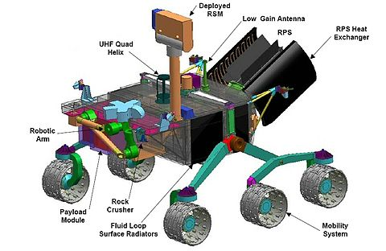
The spacecraft’s built-in Laboratory:
Tiny Spectrometer (AS7265x)
What is Light Spectroscopy?
AS7265x Triad Spectroscopy Sensor
Price
Sub-team representer:
Med. Hedi Ben Jmeaa

Slide 5
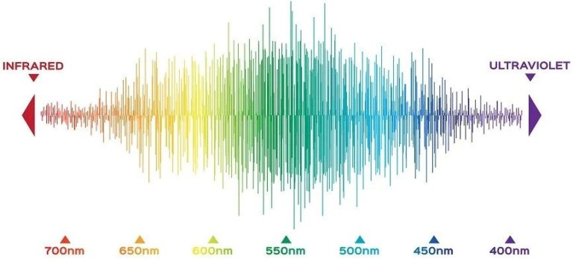
Tiny Spectrometer
Reflectance spectrometers work on a simple principle: different things reflect different wavelengths in different amounts, and because similar materials do this similarly, the measurements can be used as a kind of fingerprint or signature.

Slide 6
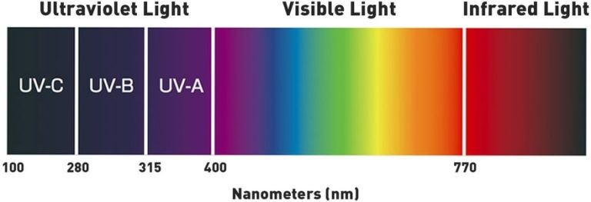
II. Light Spectroscopy
The term Spectroscopy means the study of the interaction between matter and electromagnetic radiation as a function of the wavelength or frequency of the radiation. In simpler terms, spectroscopy is the precise study of color as generalized from visible light to all bands of the electromagnetic spectrum. By performing this dissection and analysis of an object’s light, the researcher can infer the physical properties of that object such as temperature, mass, luminosity, and composition.

Slide 7
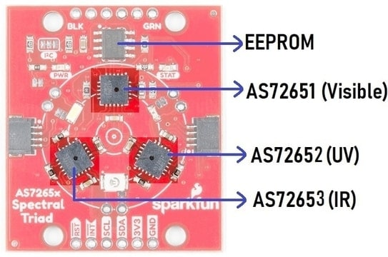
III. AS7265x Triad Spectroscopy Sensor
The AS7265x is the simplest Triad Spectroscopy Sensor from Sparkfun which can also be called a Spectrophotometer. The sensor is formed by combining three sensors AS72651, AS72652 & AS72653. The AS72651 is for measuring the visible light spectrum. Similarly, AS72652 is for measuring UV Light. The AS72653 is an IR Sensor for measuring IR Radiation.

Slide 8
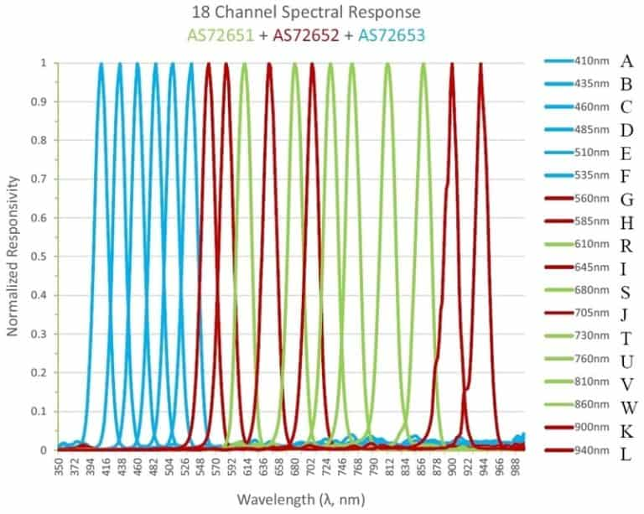
The AS7265x Triad Spectroscopy Spectral Sensor detects light from a wavelength of 410 nm to 940nm. The sensor has the ability to measure 18 individual light frequencies with precision down to 28.6 nW/cm2 and accuracy of +/-12%. The sensor operates at a typical voltage of 3.3V. The sensor has I2C pins as SDA (Serial Data) & SCL (Serial Clock) with an I2C address of 0x49. The default baud rate for the sensor is 115200.

Slide 9
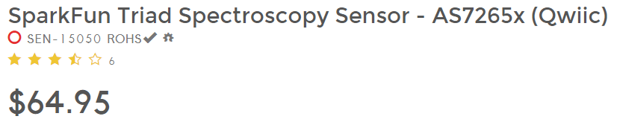
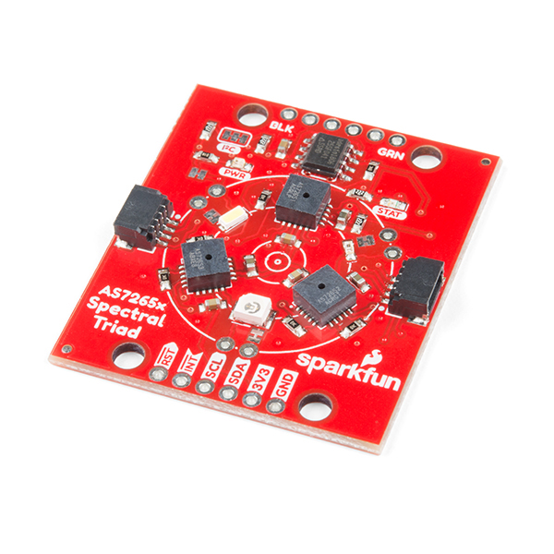
IV. Price
This product can be accessed through Sparkfun’s official website for 65$ containing the whole three sensors that make the AS726x spectrophotometer.

Slide 10
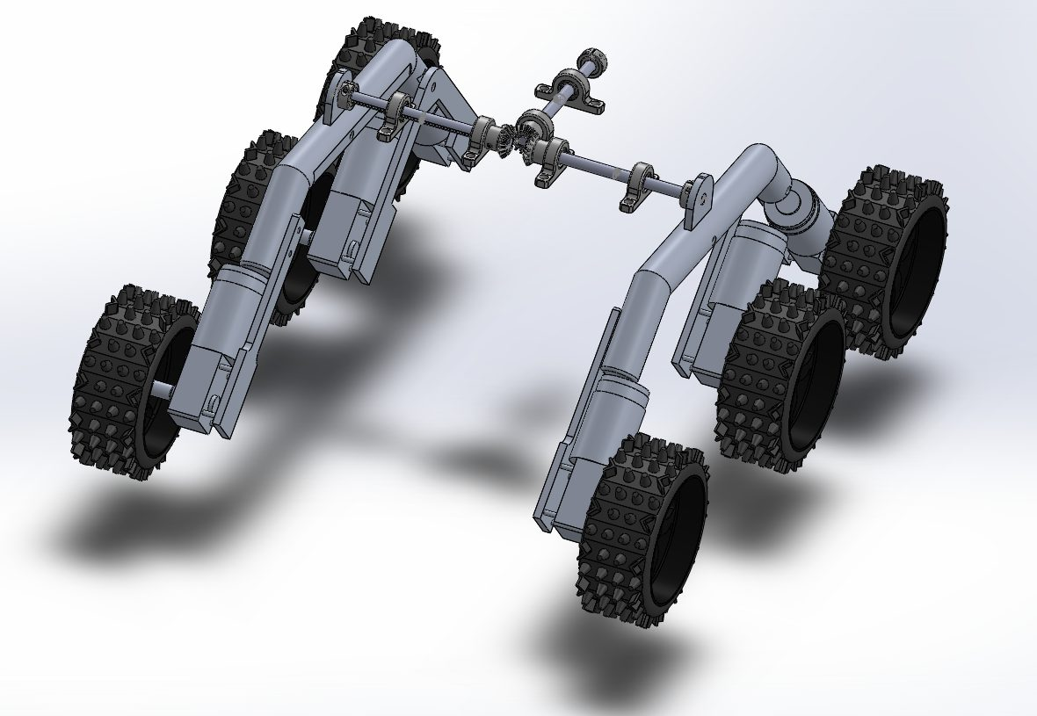
The spacecraft’s Drive-Train Mechanism:
I. Exploring other rovers’ drive trains.
II. Learning about the suspension structure of the rover.
Sub-team representer:
Yasmine Kharrat

Slide 11
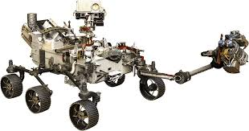
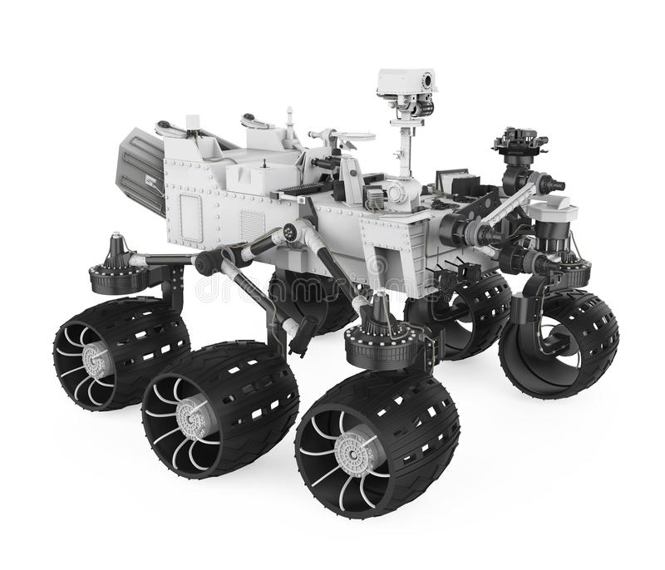
I) Exploring other rovers drive trains:
Curiosity rover
Perseverance rover

Slide 12
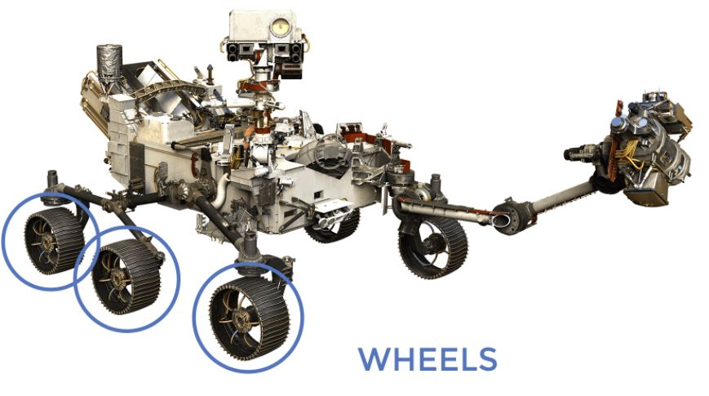
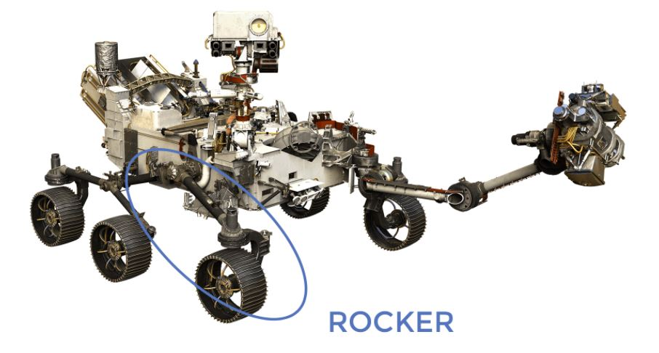
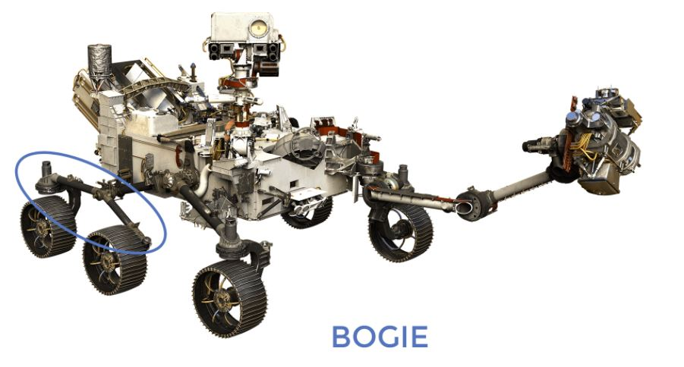
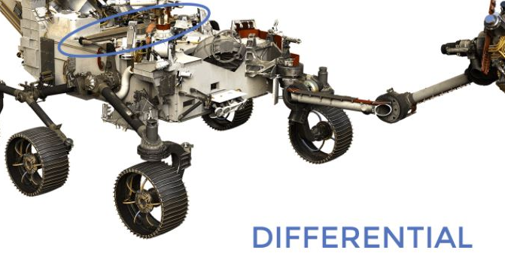
II) Learning about the suspension structure:

Slide 13
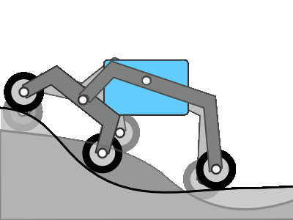

Slide 14
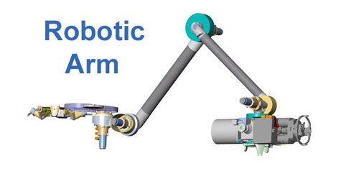
The spacecraft’s Intake Arm Mechanism:
I. Characteristics.
II. Design Process.
III. Detailed Structure.
IV. Final Product.
Sub-team representer:
E. Lahiani
Notes:
Introduction to the mechanism

Slide 15
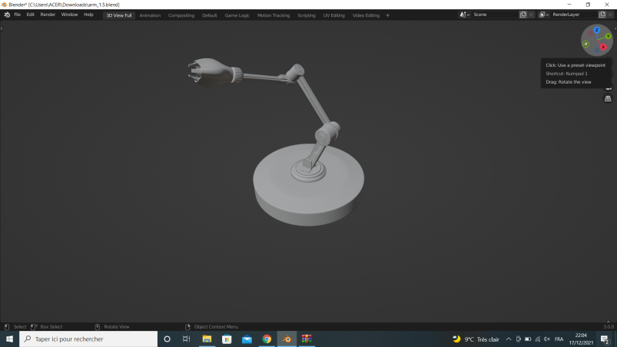
Characteristics:
- Is 90 cm long.
- Has 3 joints ( like a human arm: shoulder, elbow & wrist)
- Contains 5 geared motors to enable these movements:
*) The shoulder movement.
*) The elbow movement.
*) The wrist movement.

Slide 16
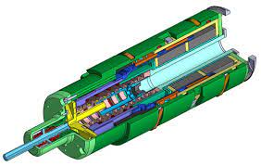
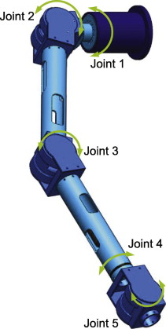
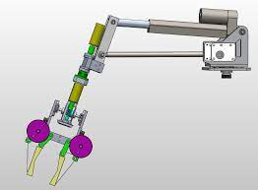
II. Design Process:
Dust-drill under protection shield
Mech(1): Takes in particles like a simplified human arm
Mech(2): Takes in particles like a vacuum machine
Our chosen mechanism takes in particles through a drill
Mechanism (2)
Mechanism (1)
Footer Notes:
Evolution of the design
A look at the inside
Side note:
Mechanism (1) & (2) were discarded due to inefficiency when operating and excessive mass.
Notes:
This is the design process

Slide 17
II. Detailed Structure:
SHOULDER:
2 motors: horizontal and vertical movements. Moves in the horizontal plane 160°. If arm moves farther left/right, it hits front rocker-bogie portion of the wheel suspension. Moves the arm through 70° in the vertical plane.
ELBOW:
The elbow joint is powered by 1 motor and can move through 290°, folding it up or out.
WRIST:
2 motors in the wrist twist the instruments vertically and horizontally placing them _| target surface.
By: E. Lahiani
Footer notes: = Shoulder, = Elbow, = Wrist, “_|” = perpendicular.

Slide 18
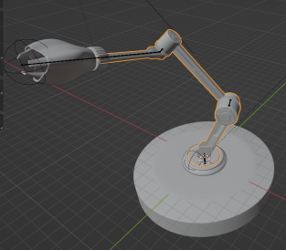
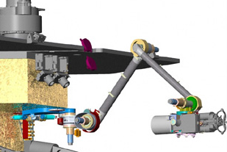
IV. Final Product:
Without Shield:
With Shield:
Notes:
Final product

Slide 19
2-
The mission of the Future

Slide 20
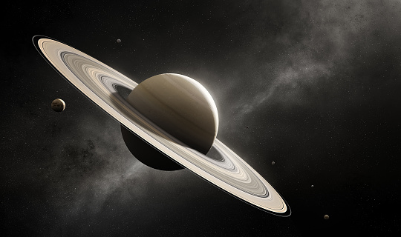
Saturn-Titan Planetary Mission
Unsurprisingly, we haven't created many successful missions to outer space.
The ones that were successful though were very close by, e.g Mars and Venus.
And that is because scientists think that maybe these planets contain an answer as to why and how we are here and whether we can live there or not.
Research team representer:
E. Lahiani

Slide 21
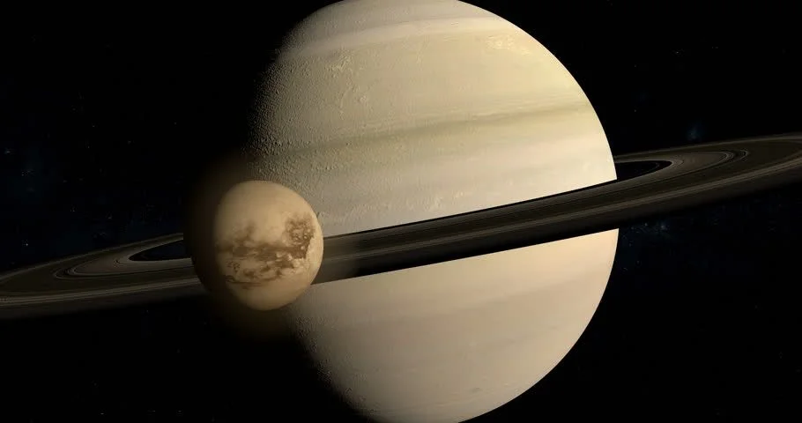
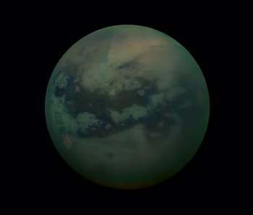

However, when working on such missions, scientists were more focused on getting videos and photos, but discarded another very important sense we, humans, can also experience: audio.
And that is just the beginning of our research…

Slide 22
3-
Our feelings, our visions and general conclusions

Slide 23
Currently, we are still in the very beginning of our long journey of research.
The research we’ve done so far, however, made us realise something; how human scientists are.
We usually have in mind that silly idea that we are in the era of advancement where everything is between your hands by the click of a button, but … this era is just the beginning of it all.
Scientists are still, to this day, searching for the answer to the simplest question:
“How did we come here?”

Slide 24
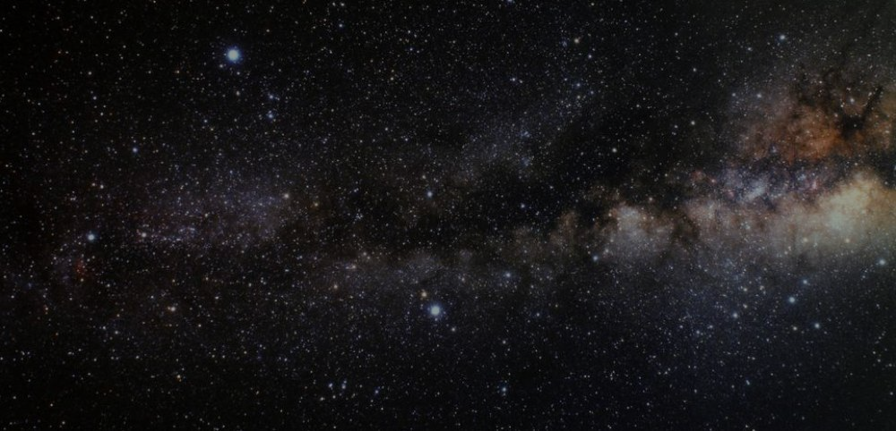
… But scientists… they aren’t in fact normal humans, as we stated before.
Because, when faced with such boundaries, they never cease to break them apart, surpassing all obstacles, challenging all the odds to create unexpected solutions.
And THIS is what we aim for, what we dream of and what we hope to achieve one day.
And one day, one fateful, fruitful day, we will come to an answer to the question we asked.
– E. Lahiani

Slide 25
4- References:
Design-related:
More about it here
- Curiosity: here
- Perseverance: here
- Mars: here
Drivetrain-related:
- Mars 3D Model: here
- This interesting website: here
Rovers:
- Perseverance: here
- Curiosity: here
More on the Cassini-Huygens Spacecraft (our inspiration for the Saturn-Titan mission): here

Slide 26
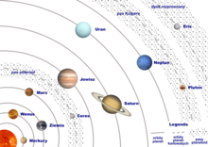
Thank you for your attention.

